Slide 1
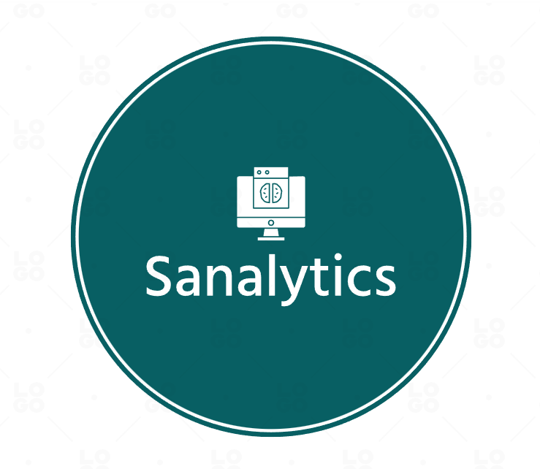
Final Project
By : Matthew Sabo

Slide 2

Company Mission
To enable business around the world to make informed business decisions by using Artificial Intelligence.
Having a reliable and affordable service

Slide 3

Functions
Provide a service that would allow companies to upload data and then ask questions to make more informed business decisions

Slide 4

Products & Organization
Website to login and pay for services
Data center for data storage
Artificial Intelligence System

Slide 5
Customers
Would be beneficial to companies of any size
Small companies would be able to use the answers generated to grow their business
Larger companies would be able to make more informed decisions

Slide 6
Suppliers and Competitors
Suppliers
Will need to work with networking companies to make sure that our service will be able to be accessed globally
Will need to work with multiple hardware companies to ensure that we have the hardware capabilities to provide fast response times to our users
Competitors
Since the field of artificial intelligence analytics is new, there is a lot of competition to create the most efficient System. How we will combat this is with faster response times, global access to the system, and cheaper pricing than the competition

Slide 7
Constraints and Future Direction
Constraints
Storage of Data
Minimizing Downtime
Future Direction
Support for Multiple Languages
Expand into more markets
Reliability and higher speeds

Slide 8
SWOT Analysis
Strengths
Ability to be used in any type of business
Trailblazing the Market
Affordable and Reliable
Weaknesses
Weak Brand
Opportunities
Opportunity to become a leader in an upcoming market
Appealing to more corporations
Creating a more reliable network across the globe
Threats
Other Competitors
Hardware and System Failures
Lack of Involvement in other Markets
Lack of Capital

Slide 9

Project Proposal
Artificial Intelligence Driven Data Analysis and Consulting Service
Allows users to upload data and be able to receive answers to questions based on the data given

Slide 10

Why Should This Project be Done?
To get ahead of the current market and become an early leader in A.I. data analysis
The project will also allow us to build a stronger brand and generate more capital

Slide 11
Costs and Risks
Costs
Estimated around $50 million
Release projected for Q1 2026
Risks
Doing the Project:
May not be successful
May take more time and/or money than initially estimated
Not doing the Project:
Competitors would take our place
Will be harder to compete in the future

Slide 12

Productivity and Alternatives
The effect on productivity will be dependent on how many developers we hire but there would be a minimal loss of productivity in other projects
Since this market is up and coming, there isn't many alternatives that we would be able to use

Slide 13
What Defines Success?
We will obtain success is when we release the product and generate profit
The return of investment will take around 5 years depending on how successful the product is

Slide 14
Measurability of Project
Measure of Results
The result of the system would be able to be measured in how effective the result was to a company
Since the result is measurable, it will be able to produce better results with time
Who would benefit more from using the system?
Both customers and the company would benefit from using the system due to the benefit it has for both parties
Measure of Revenue
Will increase revenue by being a product that would be marketed towards businesses
Will have a subscription-based payment model which would bill monthly or yearly

Slide 15
Longevity and Resource Needs of Project
Longevity of Project
Planned to be updated after release
Support is estimated to last at least 10 years
Support will last as long as the company wants to keep supporting it
Resource Needs
We would need to hire developers to work on the project, but we would be able to transfer developers from other projects
We would also need more funds to complete this project

Slide 16
Work Breakdown Structure
Task ID | Task | Start Date | End Date | Duration(Days)
1.1 | Define Project Scope and Requirements | 4/11/2023 | 4/18/2023 | 7
1.2 | Develop Project Plan and Timeline | 4/18/2023 | 4/25/2023 | 7
1.3 | Define End Goal | 4/18/2023 | 4/19/2023 | 1
2.1 | Determine Relevent Information to give A.I. | 4/25/2023 | 5/9/2023 | 14
2.2 | Collect and Process Data | 5/9/2023 | 5/9/2024 | 366
2.2.1 | Clean Collected Data | 5/9/2024 | 8/9/2024 | 92
2.3 | Label Data for Processing | 8/9/2024 | 11/9/2024 | 92
3.1 | Develop A.I. Model | 11/9/2024 | 3/9/2025 | 120
3.2 | Select Machine Learning Algorithm | 11/9/2024 | 11/16/2024 | 7
3.3 | Train Model with Machine Learning Algorithm | 3/9/2025 | 8/9/2025 | 153
3.4 | Test A.I. for Accuracy | 8/9/2025 | 2/9/2026 | 184
4.1 | Develop API for A.I. Output | 2/9/2026 | 3/9/2026 | 28
4.2 | Create Documentation and User Manuals | 2/9/2026 | 2/23/2026 | 14
5.1 | Release to the Public | 2/23/2026 | 2/24/2026 | 1

Slide 17
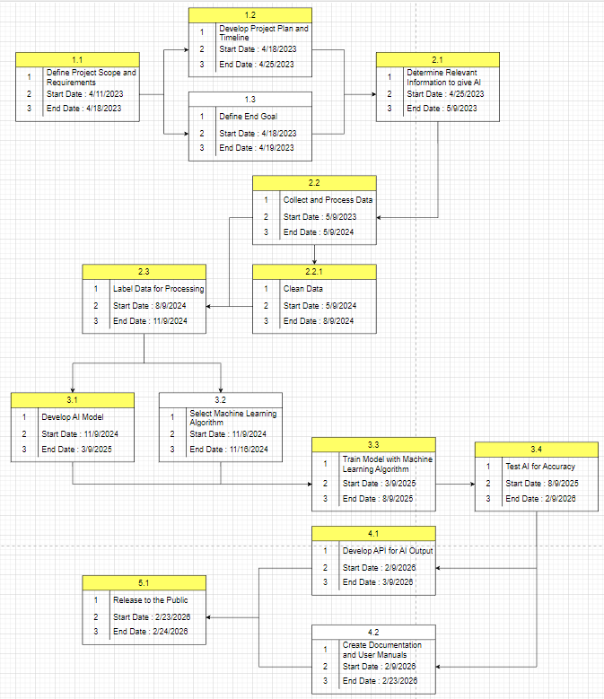
PERT Chart with Critical Path

Slide 18
Gantt Chart

Slide 19
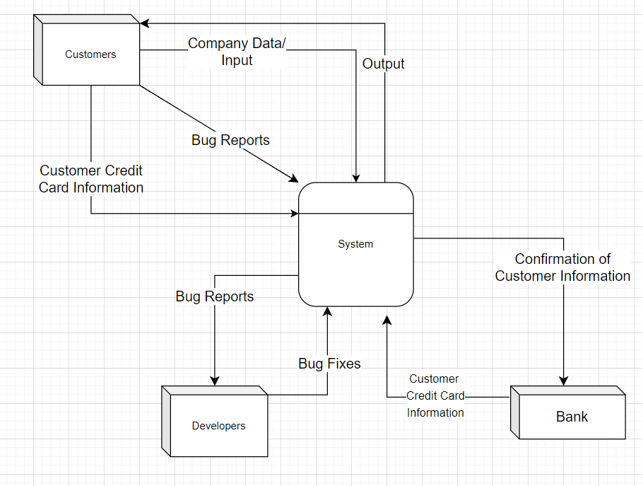
Context Diagram

Slide 20
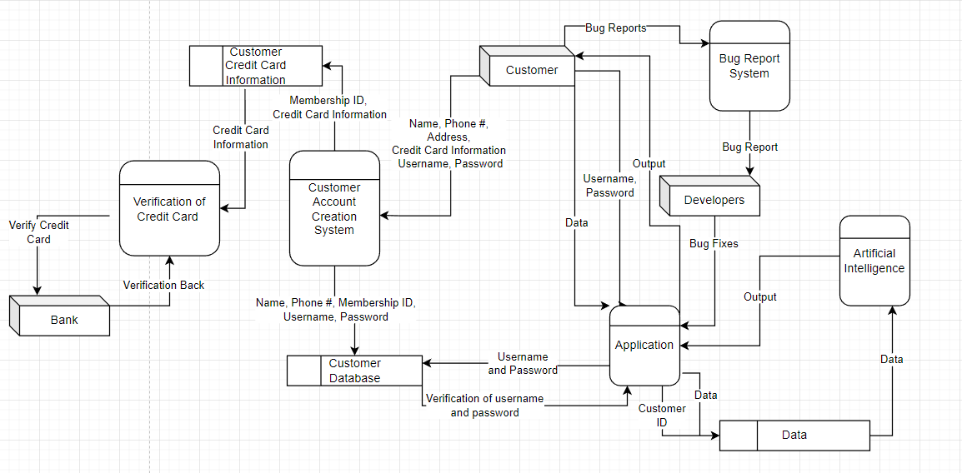
Data Flow Diagram

Slide 21
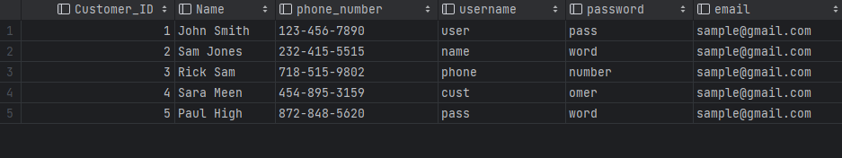
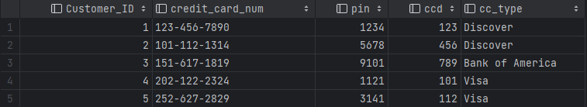
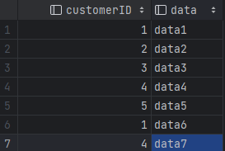
Database Design
Credit Card Information Table
User Table
Data Table

Slide 22
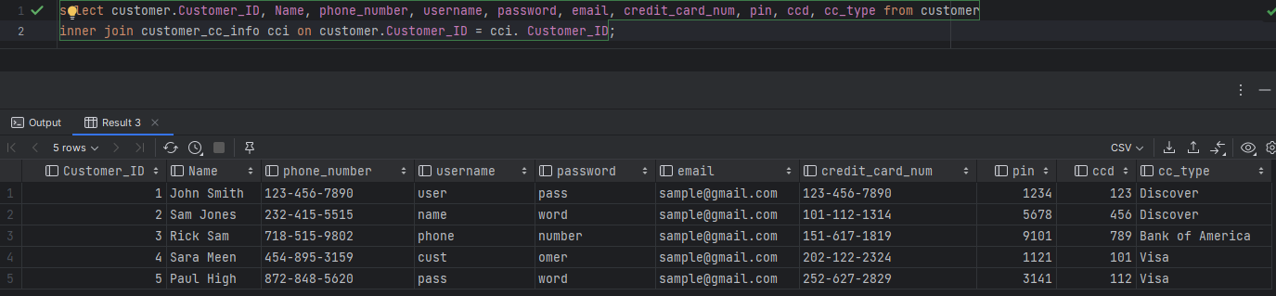
Output All Information about a Customer

Slide 23
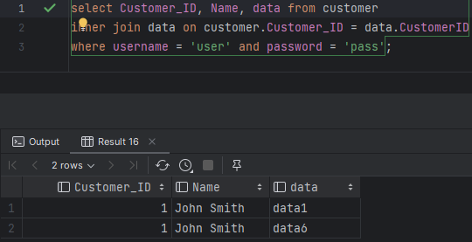
Check what Data a User has Stored Under a Specific Username and Password

